Slide 1
Raspberry Pi

Slide 2
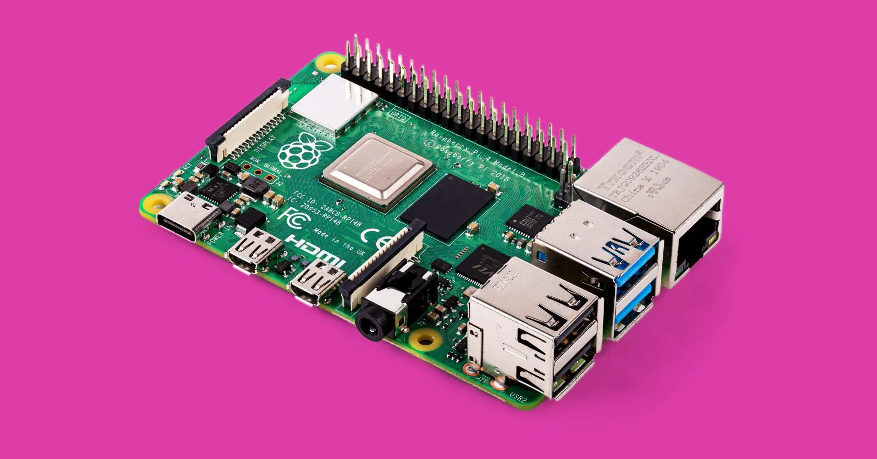
What is the Raspberry Pi?

Slide 3
Introductory Video
https://vimeo.com/raspberrypi/what-is-a-raspberry-pi

Slide 4
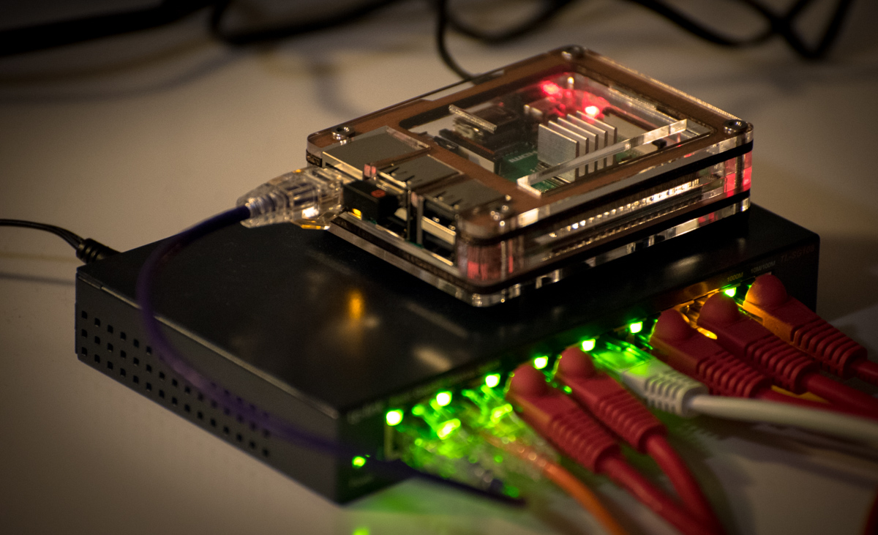
What are we going to do with the Raspberry Pi?
We will be making a web server to host and deploy various applications such as:
a basic website,
a timer application,
and a chat message application.

Slide 5
What is a Web Server?
https://www.youtube.com/watch?v=KkVE53z8W9k

Slide 6
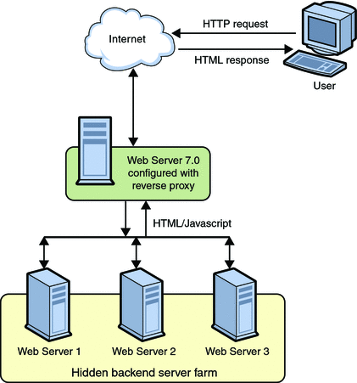
Web Server
Flowchart

Slide 7
Raspberry Pi Web Server
This is where the Raspberry Pi comes in.
Our web server is the Raspberry Pi and in the future when we have it set up, we can visit pages outside of our Raspberry Pi.

Slide 8
Why Should We Use a Pi?
Typically web servers are running 24/7. A Pi is a cheap, affordable computer that can be easily replaced if broken.
Raspberry Pis are able to run for long periods of time without breaking.

Slide 9
Website? HTML?
This week we’ll be using the Raspberry Pi web server to host websites.
https://youtu.be/KKaaGPoa7Ug

Slide 10
Backend?
There are usually two sides to website development. Frontend… and Backend.
The Frontend deals with how a website looks and how information is organized onto it.
The Backend deals with the storage of data and management of servers.
https://www.youtube.com/watch?v=9b0fAMlDe4E

Slide 11
Python
We’re going to be using Python as the main language of development for this week. It’ll be how we’re going to code our Raspberry Pi to serve our webpage.
https://www.youtube.com/watch?v=7bMDPfWiRfI

Slide 12
Flask
Flask is a web framework. This means flask provides you with tools, libraries and technologies that allow you to build a web application. This web application can be some web pages, a blog, a wiki or go as big as a web-based calendar application or a commercial website.

Slide 13
GET and POST requests
For our webserver, we want it to handle GET and POST requests.
A GET request is a request made by your computer to get information.
A POST request is a request made by your computer to give information or post it to the server.
https://www.youtube.com/watch?v=QD4GlXtf-WU

Slide 14
Let’s Play Around With the Raspberry Pis
https://www.youtube.com/watch?v=wvxCNQ5AYPg

